Slide 1
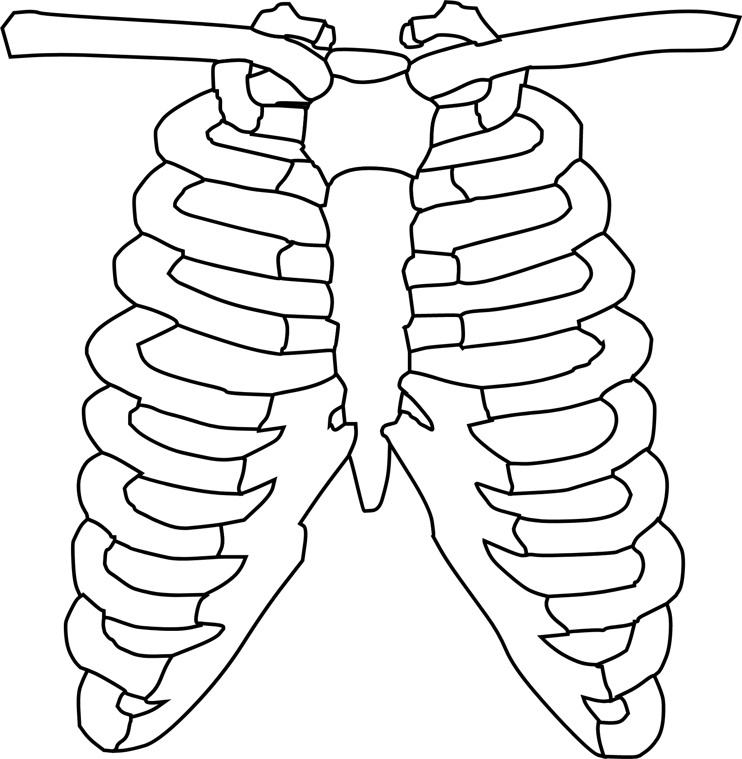
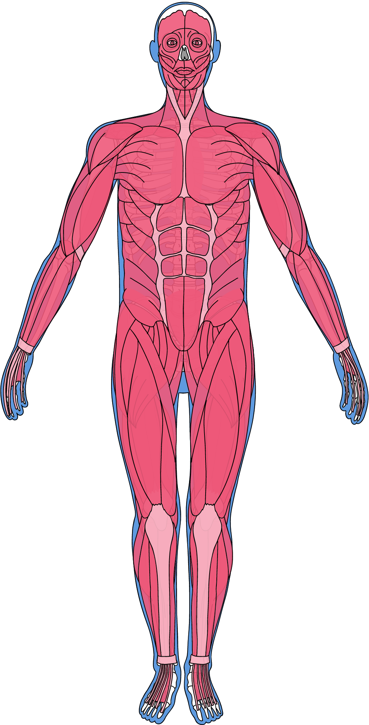
ENERGY EFFICIENT LUNG TUMOR SEGMENTATION
Notes:
Good afternoon, everyone. Today, we're going to talk about our project: Energy Efficient Lung Tumor Segmentation. This project aims to help doctors find and measure lung tumors more easily and efficiently.

Slide 2
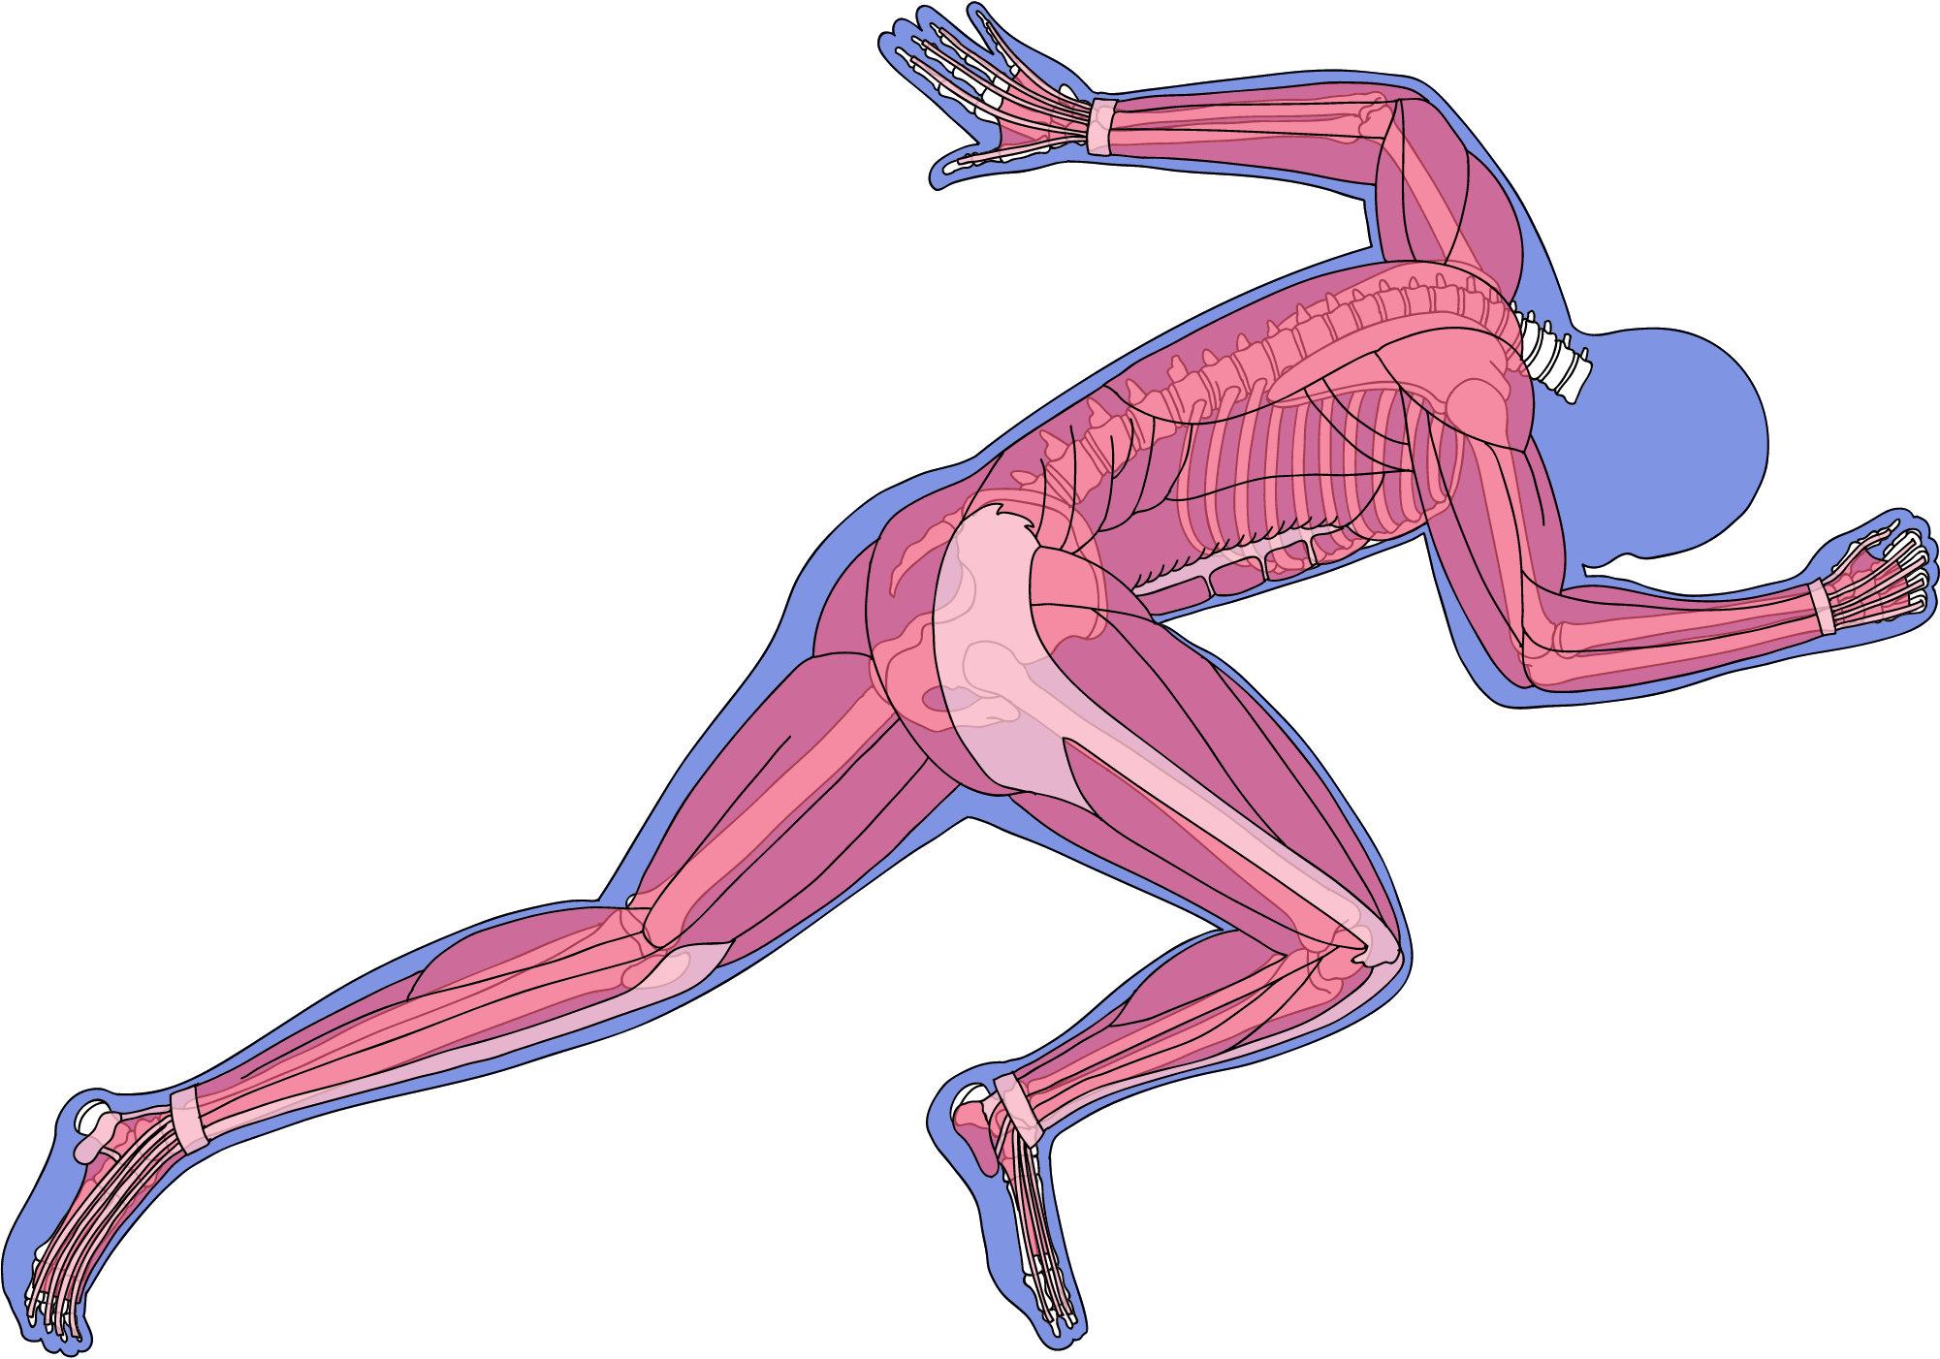
Lung Cancer / Bronchial Carcinoma:
~25% of all cancer-related deaths
1 in 16 people develop lung cancer in their lifetime
INTRODUCTION
1
Goal: Develop energy-efficient, hospital-friendly lung tumor segmentation model
2
Advantages of Automation:
Reduce false negative rate
Provide initial tumor size/volume estimate
3
Notes:
Let's start by looking at why this project is so important.
Lung cancer is a big problem. It causes about 25% of all cancer-related deaths. This means that out of every four people who die from cancer, one of them died from lung cancer. It's a scary thought, but about 1 in 16 people will get lung cancer at some point in their lives.
Because of these numbers, we need to find better ways to spot and measure lung tumors. That's where our project comes in. We want to create a computer system that can automatically find and outline tumors in lung scans.
This system will have two big advantages:
1. It will help reduce missed tumors. Sometimes, even trained doctors can miss a tumor, especially if it's small. Our system will act like a second pair of eyes, catching things that might be missed.
2. It will automatically measure the size of tumors. This is really important because the size of a tumor helps doctors decide how serious it is and what kind of treatment to use.
The best part is that this system will make life easier for radiologists - the doctors who look at these scans. Instead of having to carefully outline each tumor by hand, they'll be able to use our system to do most of the work. Then, they'll just need to check and make any small corrections.

Slide 3
ENERGY EFFICIENCY AND IMPACT
Focus on Energy Efficiency:
• Hospital-friendly for continuous hours of usage
• No need for fancy hardware setups
• Low power consumption compared to GPU-based solutions
Impact:
• Simplifies radiologists’ work
• Reduces manual segmentation, focusing on corrections
• Potential for improved diagnosis and treatment planning
Notes:
Now, you might be wondering why we're focusing so much on making this system energy efficient. There are a few really important reasons:
1. Hospitals need to be able to use this system for hours at a time without it breaking down or costing too much to run.
2. We don't want hospitals to need expensive, special computers to run our system. It should work on the computers they already have.
3. By using less power, we're not only saving the hospital money, but we're also being kinder to the environment.
This is different from many other systems that need powerful, energy-hungry graphics cards to run. Our system aims to do the job just as well, but using much less power.
The impact of this project could be huge:
- It will make the radiologists' job easier. Instead of spending hours carefully outlining tumors, they can focus on checking the computer's work and making any needed adjustments.
- This could lead to faster and more accurate diagnoses. The quicker a tumor is found and measured correctly, the sooner a patient can start getting the right treatment.
- In the long run, this could help improve cancer treatment and maybe even save lives.

Slide 4
DATASET
Lung Tumor Segmentation dataset (Medical Segmentation Decathlon challenge) :
SIZE: 96 3D VOLUMES (64 TRAINING + 32 TESTING)
TARGET: LUNG AND TUMORS
MODALITY: CT
CHALLENGE: SMALL TARGET (CANCER) IN A LARGE IMAGE
SOURCE: THE CANCER IMAGING ARCHIVE
Notes:
Now, let's talk about how we're going to build this system.
To teach a computer to find tumors, we need to show it lots of examples. That's where our dataset comes in. We're using a special set of lung scans from something called the Medical Segmentation Decathlon challenge.
Here's what our dataset looks like:
- We have 96 3D scans of lungs. 64 of these will be used to train our system, and 32 will be used to test how well it works.
- Each scan is like a 3D picture of someone's chest. Imagine a cube made up of lots of 2D pictures stacked on top of each other.
- Each of these 3D pictures is pretty big - 512 pixels wide, 512 pixels tall, and 276 pixels deep.
- All of these scans come from a trusted source called The Cancer Imaging Archive.
Now, here's the tricky part: tumors are usually pretty small compared to the whole lung. So our system needs to be really good at finding small, important areas in these big 3D pictures. It's like trying to find a tiny island in a big ocean.
In total, we have 31,534 2D slices to work with. That's a lot of data for our system to learn from!
AFTER SHOWING DATA - SHARAN
## Conclusion
To wrap up, our Energy Efficient Lung Tumor Segmentation project is aiming to create a powerful tool in the fight against lung cancer. By combining advanced computer techniques with a focus on practical, efficient design, we hope to create a system that can make a real difference in hospitals around the world. Thank you for your attention, and I'm happy to answer any questions you might have.

Slide 5
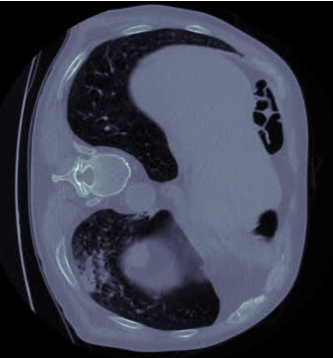
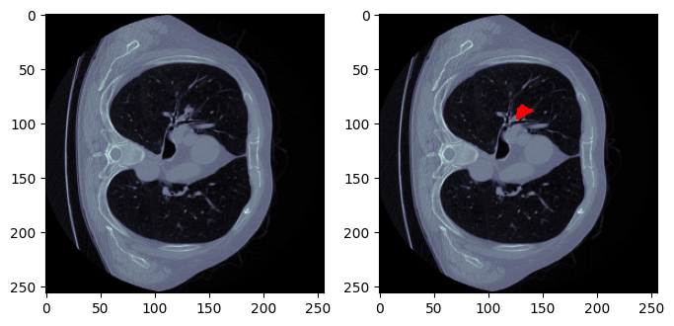
DATASET CHALLENGE
non-tumorous slices = 15142
tumorous slices = 1947
Ratio = 7.777092963533642
Notes:
The biggest challenge of this dataset is the small tumor size in a CT scan. This causes a class imbalance of the tumor and the background class dominating in a single slice. Moreover,
along with this internal imbalance, there’s also an imbalance throughout the dataset where only 1947 slices contain a tumor whereas the remaining 15142 slices are empty, leading to a 1:8 ratio imbalance.
The solution to this problem is to use weighted oversampling. This allows us to sample slices containing a tumor 8 times more frequently compared to a non-tumorous slice which then helps the model to learn and identify these tumors.

Slide 6
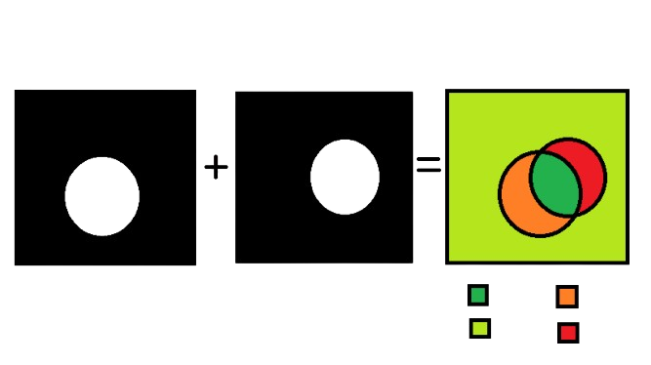
Calculation of Metrics
Prediction
True label
TP
FP
TN
FN
Notes:
Next, we will explain how our evaluation metrics have been calculated. Consider the left side segmentation mask to be the model’s prediction and the right side mask to be the true value. We overlap these 2 masks and now obtain the necessary values we need. True positive values are wherever the prediction and true values of the tumor overlap while True negatives is the overlap between the backgound. False positives occur when the model predicts the mask where the tumor actually isn’t present and False negatives occur when the model doesn’t predict the mask over the tumor area.
The sum of all the pixels under these specific labels are then used for the calculation of our model’s evaluation metrics.

Slide 7
Evaluation Metrics
2*TP
TP
Dice Score =
Precision =
2*TP + FP + FN
TP + FP
TP
TP
Recall =
IoU =
TP + FN
TP + FP + FN
NOTE: Notice how Dice Score is essentially just F1-Score for segmentation
Notes:
The metrics we have taken into consideration are Dice score, precision, recall and Intersection over union, otherwise called the Jaccard Index.
Precision refers to how often the true label is actually positive whenever the model makes a prediction as positive.
Recall shown how often the model is able to identify whether the label is positive or not given that the true label is positive.
We can observe from the formula that the Dice score is essentially the F1-score for segmentation and hence why it is popularly used to evaluate the model’s performance.
The Intersection over Union metric is similar to the Dice metric and is calculated as the ratio between the overlap of the positive instances between two sets, and their mutual combined values. Like the Dice metric, it is a common means of evaluating the performance of pixel segmentation models.

Slide 8
Model Computational Efficiency
Model | Total Params | GMAC | Input Size | Forward/Backward pass size | Model Params size | Estimated Total Size
UNet | 7,781,761 | 42.35 GB | 0.26 MB | 243.79 MB | 31.13 MB | 275.18 MB
SegNet | 9,374,593 | 26.68 GB | 0.26 MB | 407.37 MB | 37.50 MB | 445.13 MB
ENet | 348,852 | 490.92 MB | 0.26 MB | 199.62 MB | 1.40 MB | 201.28 MB
PSPNet | 8,698,433 | 563.68 GB | 0.26 MB | 2.04 GB | 34.79 MB | 2.07 GB
Notes:
Here is some information regarding the models we have taken into consideration. Total parameters indicate the number of parameters in the model, the GMAC tells us how many matrix multiplication and addition operations are being performed in 1 forward pass and is also the measure for how energy efficient the model is. The estimated total size is the sum of Input size, Forward/Backward pass size and the Parameters size which indicates the minimum amount of memory required to load and run inference on the model. We can observe that although SegNet has more parameters, it is 37% more energy efficient due to
having a smaller number of operations but requires 38% more memory for inference while ENet is Efficient in all aspects

Slide 9
Model Performance
Full Dataset metrics
Validation metrics
Model | UNet | SegNet | ENet | UNet | SegNet | ENet
Dice Score | 0.946312 | 0.937293 | 0.895323 | 0.770587 | 0.788769 | 0.692035
Precision | 0.949983 | 0.962075 | 0.920491 | 0.773336 | 0.81479 | 0.63173
Recall | 0.942668 | 0.913756 | 0.871494 | 0.767857 | 0.76436 | 0.765069
IoU | 0.898094 | 0.881986 | 0.810484 | 0.626793 | 0.651213 | 0.529093
Notes:
Now comes the fun part we’ve been waiting for. Making a model energy efficient is well and good until it doesn’t perform well. Given here is the final metrics of our models. To our left are metrics calculated over the complete dataset and to our right are the validation metrics. We can see that UNet is having the highest metrics most of the time for testing on the whole dataset but if we look at our validation metrics, SegNet beats UNet by a small margin. ENet doesn’t perform to the level of UNet and SegNet but what more can we ask from a model having only 350k parameters :). Getting dice score of 0.89 and validation score of 0.69 is considered as a win.

Slide 10
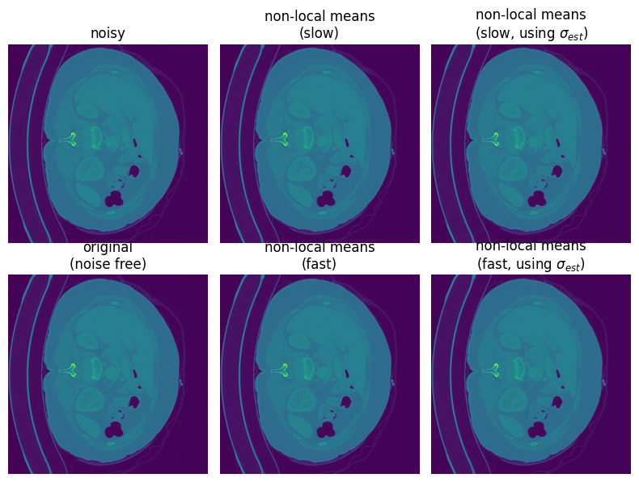
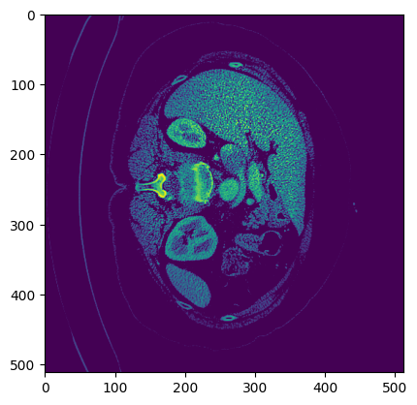
Effect of Pre-processing Techniques
Denoising (noise std = 0.0051)
Contrast Enhancement
Notes:
And finally, we take a look at the effect of pre-processing techniques like denoising and contrast enhancement. Denoising has no effect on the model’s performance because of the CT scans already having high definition without much noise as shown by the estimated noise standard deviation being only 0.5%. Contrast Enhancement on the other hand has a negative impact on the model’s performance because of the nature of the algorithm to convert the slices into an organ window where the organs of the body are more prominent and the circulatory system becomes overshadowed which is opposite to what we want which is a lung window that enhances visibility of the blood vessels inside the lungs in our CT scan which further enhances visibility of our lung nodules.

Slide 11

21bds002 : Aayushi Padia
21bds006 : Aryan T N
21bds029 : Abhiram K
21bds061 : Sharan T

